Slide 1
Extra Materials

Slide 2
More Exercise (in Lecture Note 7(a))
Suppose now I want to write a C program to compute and find out all prime numbers in the range of 2 to 1000
How are you going to tackle the problem?
What will be our outer loop?
How about our inner loop?
Hint: In this case, you can first write your inner loop first and make sure it is correct before you proceed with the outer loop.

Slide 3
Direct Approach (check ONE number)
1
2
3
4
5
6
7
8
9
10
11
12
13
14
15
#include <stdio.h> int main() { int n, isPrime = 1; printf("Input a number 2-1000: "); scanf("%d", &n); for (int i = 2; i < n; i++) if (n % i == 0) isPrime = 0; if (isPrime) printf("Prime.\n"); else printf("Composite.\n"); return 0; }
Any optimization?
Do we need to check all factors 2 to N-1?
Check factors {2} + {odd numbers}
Check up to sqrt(N)

Slide 4
Direct Approach (Faster)
1
2
3
4
5
6
7
8
9
10
11
12
13
14
15
//......
if (n % 2 == 0)
isPrime = 0;
else for (int i = 3; i*i <= n; i += 2) if (n % i == 0){ isPrime = 0;
break;
}
if (isPrime) printf("Prime.\n"); else printf("Composite.\n"); //...... }
Extend it to check all integers in [1, …, n]
Output Result

Slide 5
Combined
#include <stdio.h>
int main() {
int isPrime;
for (int n = 2; n <= 1000; n++) {
isPrime = 1;
if (n % 2 == 0)
isPrime = 0;
else
for (int i = 3; i*i <= n; i += 2)
if (n % i == 0) {
isPrime = 0;
break;
}
if (isPrime)
printf("%d is Prime.\n", n);
else
printf("%d is Composite.\n", n);
}
return 0;
}

Slide 6
Example Related to Lab 6 - Ex 5
Given an integer array int a[100]= {1, 2, 3, … ,100};
How to print the integers with the following condition?
if (N > 4), print only the first 2 and last 2.
for (int i = 0; i < N; i++)
if (i == 0 || i == 1 || i == N-2 || i == N-1)
print a[i]
else if (i==2) // "else if" is important
print “…”

Slide 7
Example
1
2
3
4
5
6
7
8
9
10
11
12
13
14
15
#include <stdio.h>
int main()
{
int a[100], N;
for (int i = 0; i < 100; i++) a[i] = i+1;
scanf("%d", &N);
for (int i = 0; i < N; i++)
if (i == 0 || i == 1 || i == N-2 || i == N-1)
printf("%d\n", a[i]);
else if (i==2) // "else" is important
printf("......\n");
}
How to print the pattern 1 -2 3 -4 … ?

Slide 8
Example
1
2
3
4
5
6
7
8
9
10
11
12
13
14
15
#include <stdio.h>
int main()
{
int a[100], N, sign = 1;
for (int i = 0; i < 100; i++) a[i] = i+1;
scanf("%d", &N);
for (int i = 0; i < N; i++){
if (i == 0 || i == 1 || i == N-2 || i == N-1)
printf("%d\n", sign * a[i]);
else if (i==2) // "else" is important
printf("......\n");
sign *= -1;
}
}
[Extra] (not useful when doing that lab)
How about printing other patterns: {1, 1, 2, 2, 3, 3, …}, {1, 2, 3, 2, 3, 4, …}
try to observe (i / 2)
check i % 3 --> {0, 1, 2, 0, 1, 2, … } and Combine (1)

Slide 9
Finding GCD (previous uReply)
Greatest common divisor between (a, b)
e.g., gcd(10, 15) = 5; gcd(12, 23) = 1;
Direct Approach
Set gcd = 1;
Check for i in the range (2, Min(a, b))
if (i is factor of both (a, b)) update gcd = i;
While-loop:
Set gcd = 1; i = 2;
while(i <= a && i <= b)
if (i is factor of (a,b))
update gcd = i;
i++;
for-loop:
limit = MIN(a, b)
Set gcd = 1;
for(int i = 2; i <= limit; i++)
if (i is factor of (a,b))
update gcd = i;

Slide 10
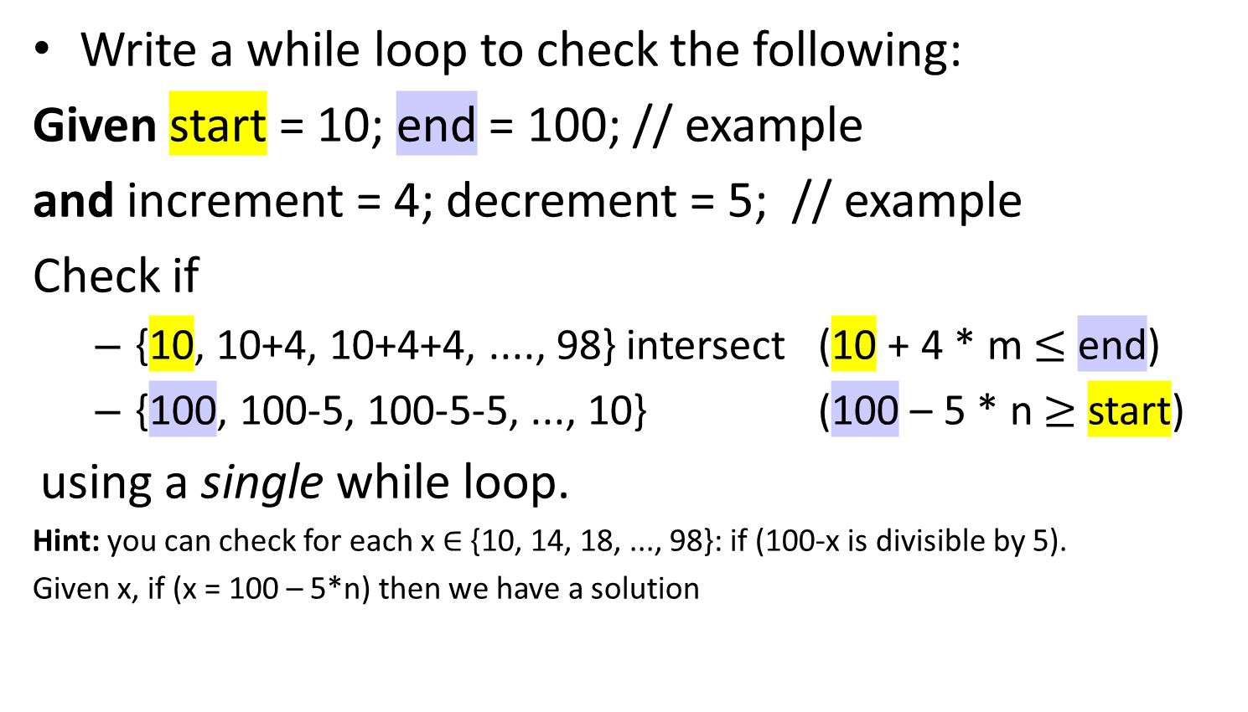
Extra
Write a while loop to check the following:
Given start = 10; end = 100; // example
and increment = 4; decrement = 5; // example
Check if
{10, 10+4, 10+4+4, ...., 98} intersect (10 + 4 * m $≤$ end)
{100, 100-5, 100-5-5, ..., 10} (100 – 5 * n $≥$ start)
using a single while loop.
Hint: you can check for each x ∈ {10, 14, 18, ..., 98}: if (100-x is divisible by 5).
Given x, if (x = 100 – 5*n) then we have a solution
(100-x = 5*n)

Slide 11
Example
1
2
3
4
5
6
7
8
9
10
11
12
13
14
15
#include <stdio.h>
void main() {
int start = 10, end = 100;
int inc = 4, dec = 5, i = 0, found = 0;
int currentX = start + inc * i;
while (currentX <= end){ // enumerate all (10 + inc*i)
if ((end - currentX) % dec == 0) {//check 100-x = 5n
printf("True");
found = 1;
}
i++;
currentX = currentX + inc;
}
if (!found) printf("False\n");
}
We can also output the solutions (m, n)

Slide 12
Example
1
2
3
4
5
6
7
8
9
10
11
12
13
14
15
#include <stdio.h>
void main() {
int start = 10, end = 100;
int inc = 4, dec = 5, i = 0, found = 0;
int currentX = start + inc * i;
while (currentX <= end){ // enumerate all (10 + inc*i)
if ((end - currentX) % dec == 0) {
printf("Solution: a = %d, b = %d\n", i, (end - currentX) / dec);
found = 1;
}
i++;
currentX = currentX + inc;
}
if (!found) printf("No solution\n");
}
We can also output the solutions (m, n)

